Slide 1


Ultrasonic
Manufacturing of Lubricating Oils
by
HILSONIC TECHNOLOGY & SERVICES LIMITED

Slide 2
Introduction
The Purpose of this presentation is to:
Highlight the benefits of using Ultrasonic Technology for Lube Oil Blending.
Introduce This New Technology for Lube Oil Blending and the parent Company that is based in the UK ( Hilsonic Technology & Services Ltd.)
ULTRASONIC MANUFACTURING
OF LUBRICATING OILS
by Hilsonic Process Systems

Slide 3
Key Benefits of Ultrasonic Technology for Lube Oil Blending
Environmental benefits through energy savings.
Financial benefits through lower operating and maintenance costs.
Increased operational efficiency.
Very low carbon footprint
10Tonnes (10,000 Liters) of Lube Oil can be manufactured in one
hour using 3kw tubular processor without heating, agitation or
moving parts.
3Tonnes (3,000 Liters) of Lube Oil can be manufactured in one
hour using 1.5kw tubular processor without heating, agitation or
moving parts.
One vessel can be used for blending and discharge to filling facilities.
Furthermore, the use of this new technology (ultrasonic method) eliminates production delays that do arise from heating, cooling and mixing high quality products. Hence, aids continuous operation
KEY BENEFITS OF ULTRASONIC TECHNOLOGY

Slide 4
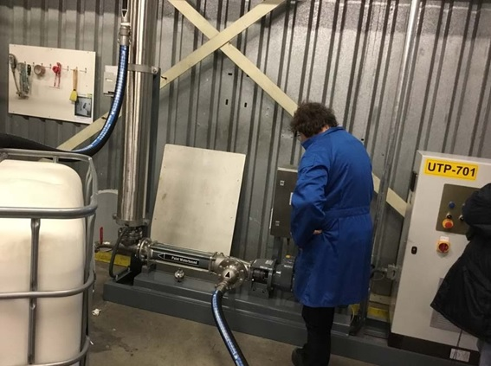
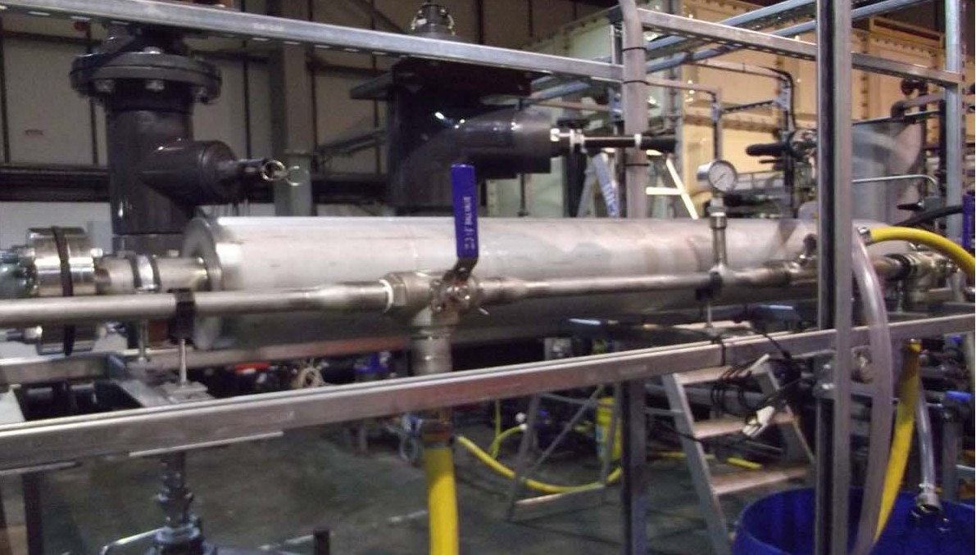
Trial Unit for 10,000 liters per hour cold processing
New installation of 10,000 litres 3kw tubular processor per hour production at customer’s site

Slide 5
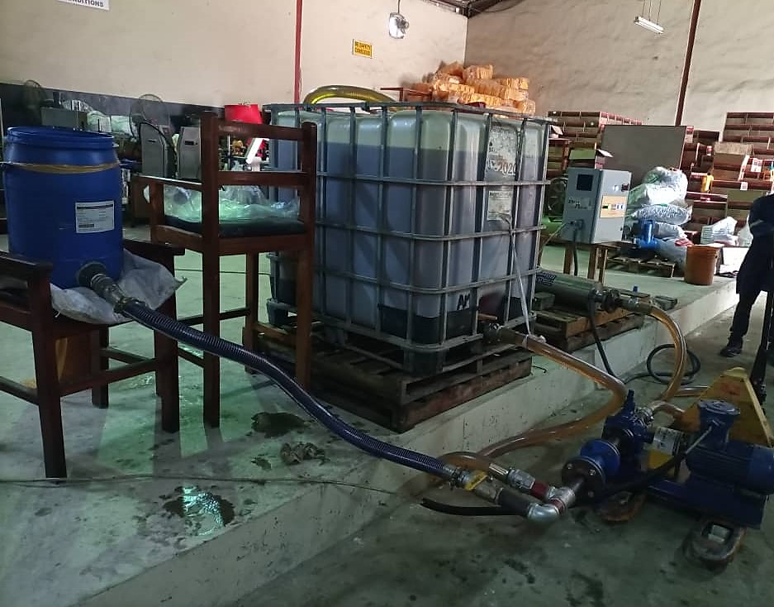
1 tonne in 20 minutes blending of heavy marine lube without heat
Trial blend at a lubricant blending factory Lagos
NEW INSTALLATION AT CUSTOMER’S SITE

Slide 6
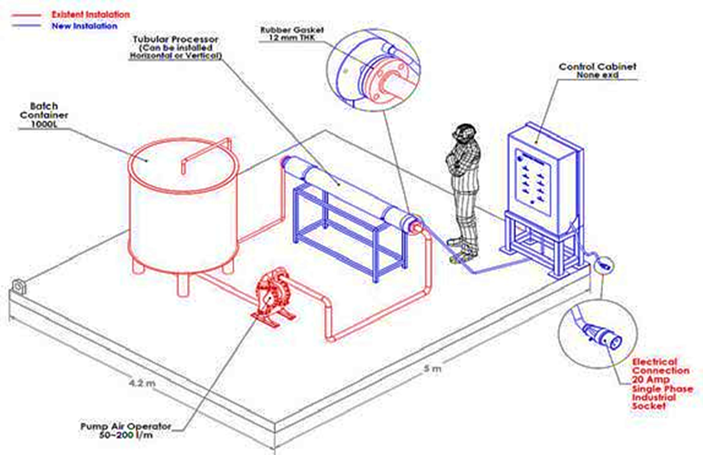
Trial Diagram Layout
TRIAL DIAGRAM
LAYOUT

Slide 7
Traditional Blending
VERSUS Ultrasonic Blending
EXISTING TECHNOLOGY (BLENDING KETTLE)
NEW TECHNOLOGY
(ULTRASONIC PROCESSOR
Heavy wall steel tanks
Steel pipes and valves required
Heating Coils
Agitators (high speed with 50 kw/hr)
Very high power operating cost (499kw/hr)
Heating and cooling required
High maintenance cost
High carbon footprint
Occupies more space
Cost 8 x higher than new technology
Plastic tanks can be utilised
Plastic pipes and valves required
No heating coils required
No agitator required
Very low power operating cost (3kw/hr)
No heating and cooling required
No maintenance cost (5 yrs guarantee
Low carbon footprint
Occupies less space
Very low cost to operate
OLD TECHNOLOGY VERSUS NEW TECHNOLOGY

Slide 8
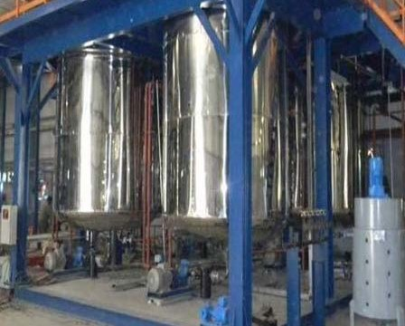
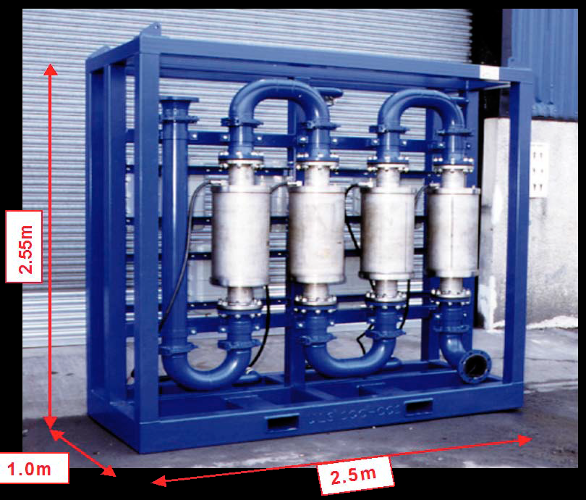
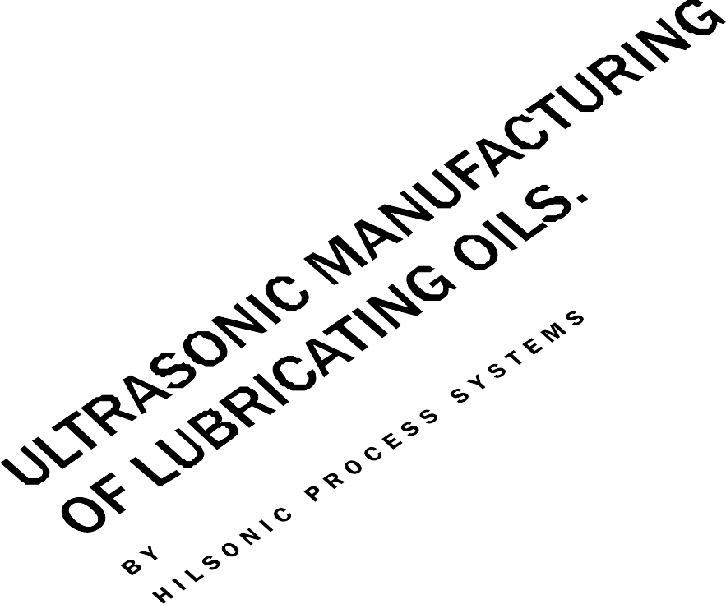
Equipment Comparison
OLD TECHNOLOGY
10 Litres per hour heated and agitated blending plant
NEW TECHNOLOGY
Forty Litres per hour.
Equipment Comparison

Slide 9
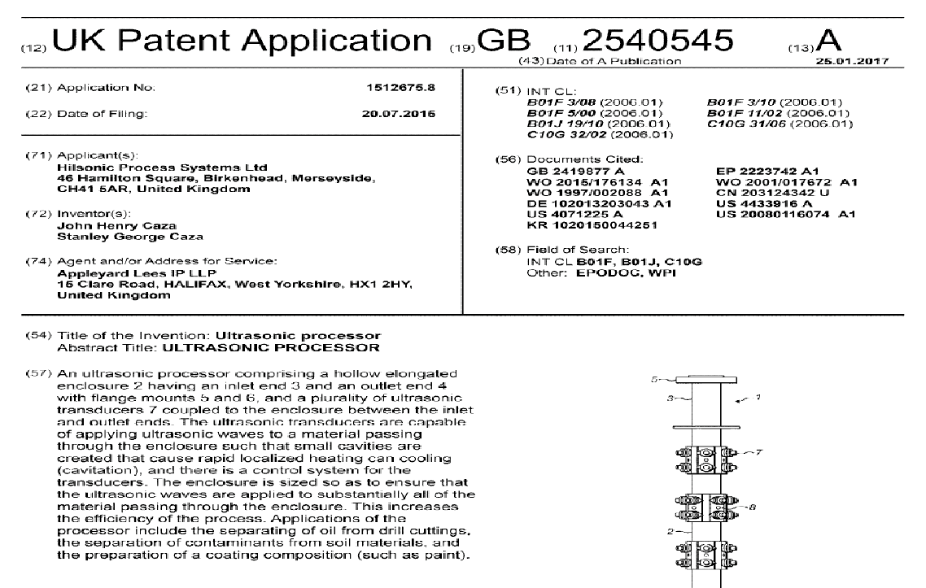
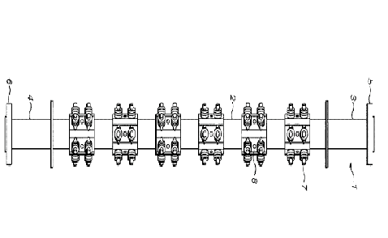
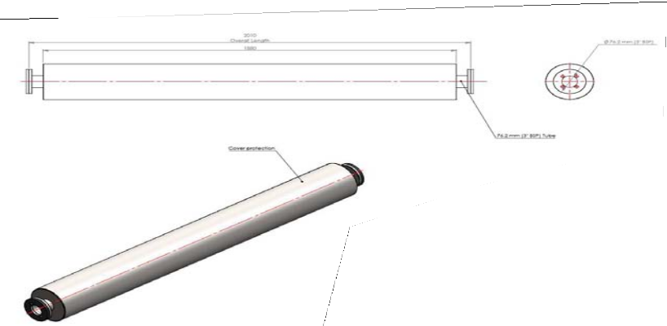

Patent for Ultrasonic Processor
Ultrasonic Tubular Processor
PATENT FOR ULTRASONIC PROCESSOR

Slide 10
Environmental Impact
Due to low power usage required for the 3kw ultrasonic processor to produce 10,000 litres of quality lube oil per hour, one client is now manufacturing 20,000 litres per hour using two processors.
Two clients in the UK are using solar power, therebye reducing the carbon footprint and energy costs.
This will have a large impact in the production of lube oil in Africa, Middle East, Asia, Europe and across the globe by dramatically reducing the global carbon footprint when blending lube oil.
ENVIRONMENTAL IMPACT

Slide 11
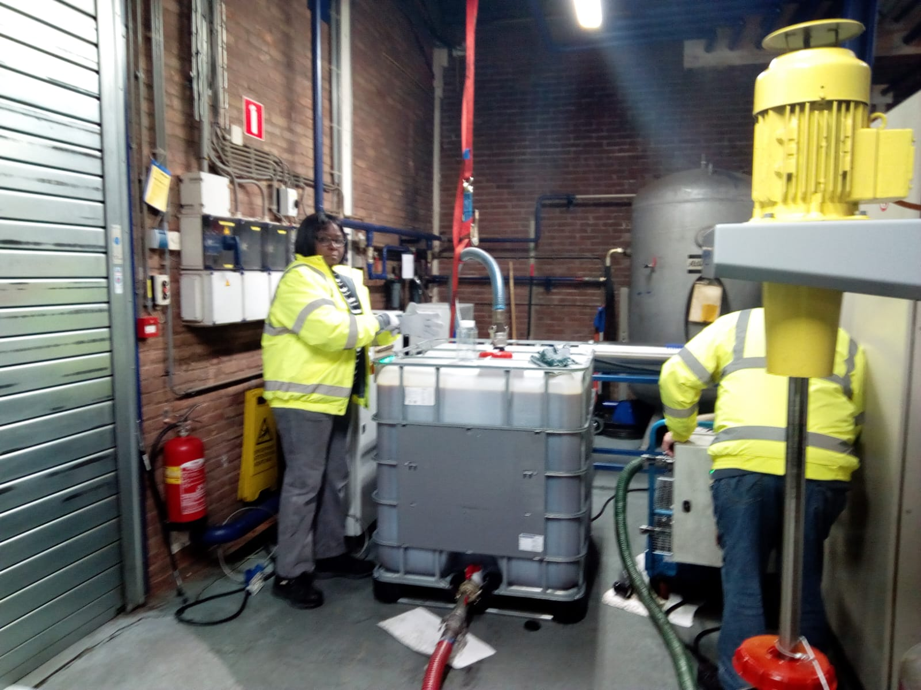
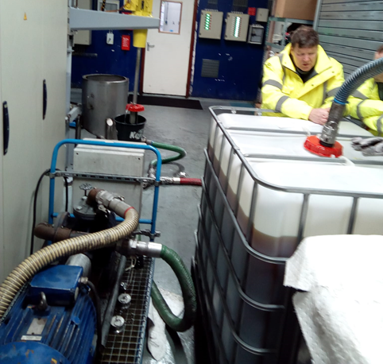
New installation of 10,000 litres per hour production at customer’s site
TRIAL UNITS FOR CUSTOMERS SITES

Slide 12
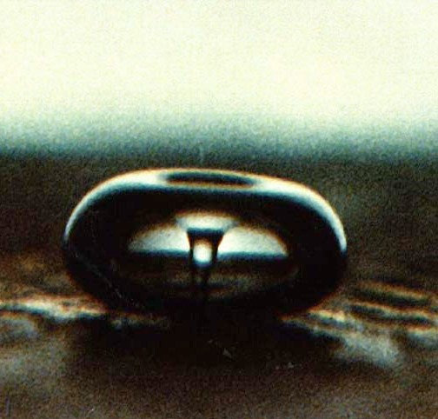
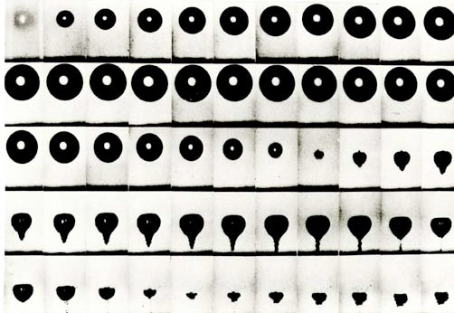
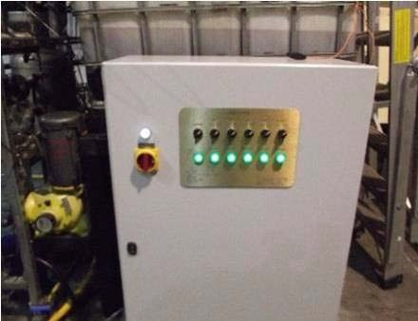
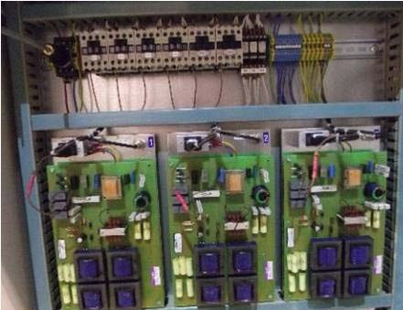
Basis Principles of Ultrasound
Figure above shows the formation of a micro jet impact with a velocity of approximately 250 miles per hour. This then creates high velocity interparticle collisions.
It deagglomerates, shears and changes viscosity.
3kW ultrasonic control panel
Modular design control panel
BASIS PRINCIPLES OF ULTRASOUND

Slide 13
NMADPRA
Certification

Slide 14
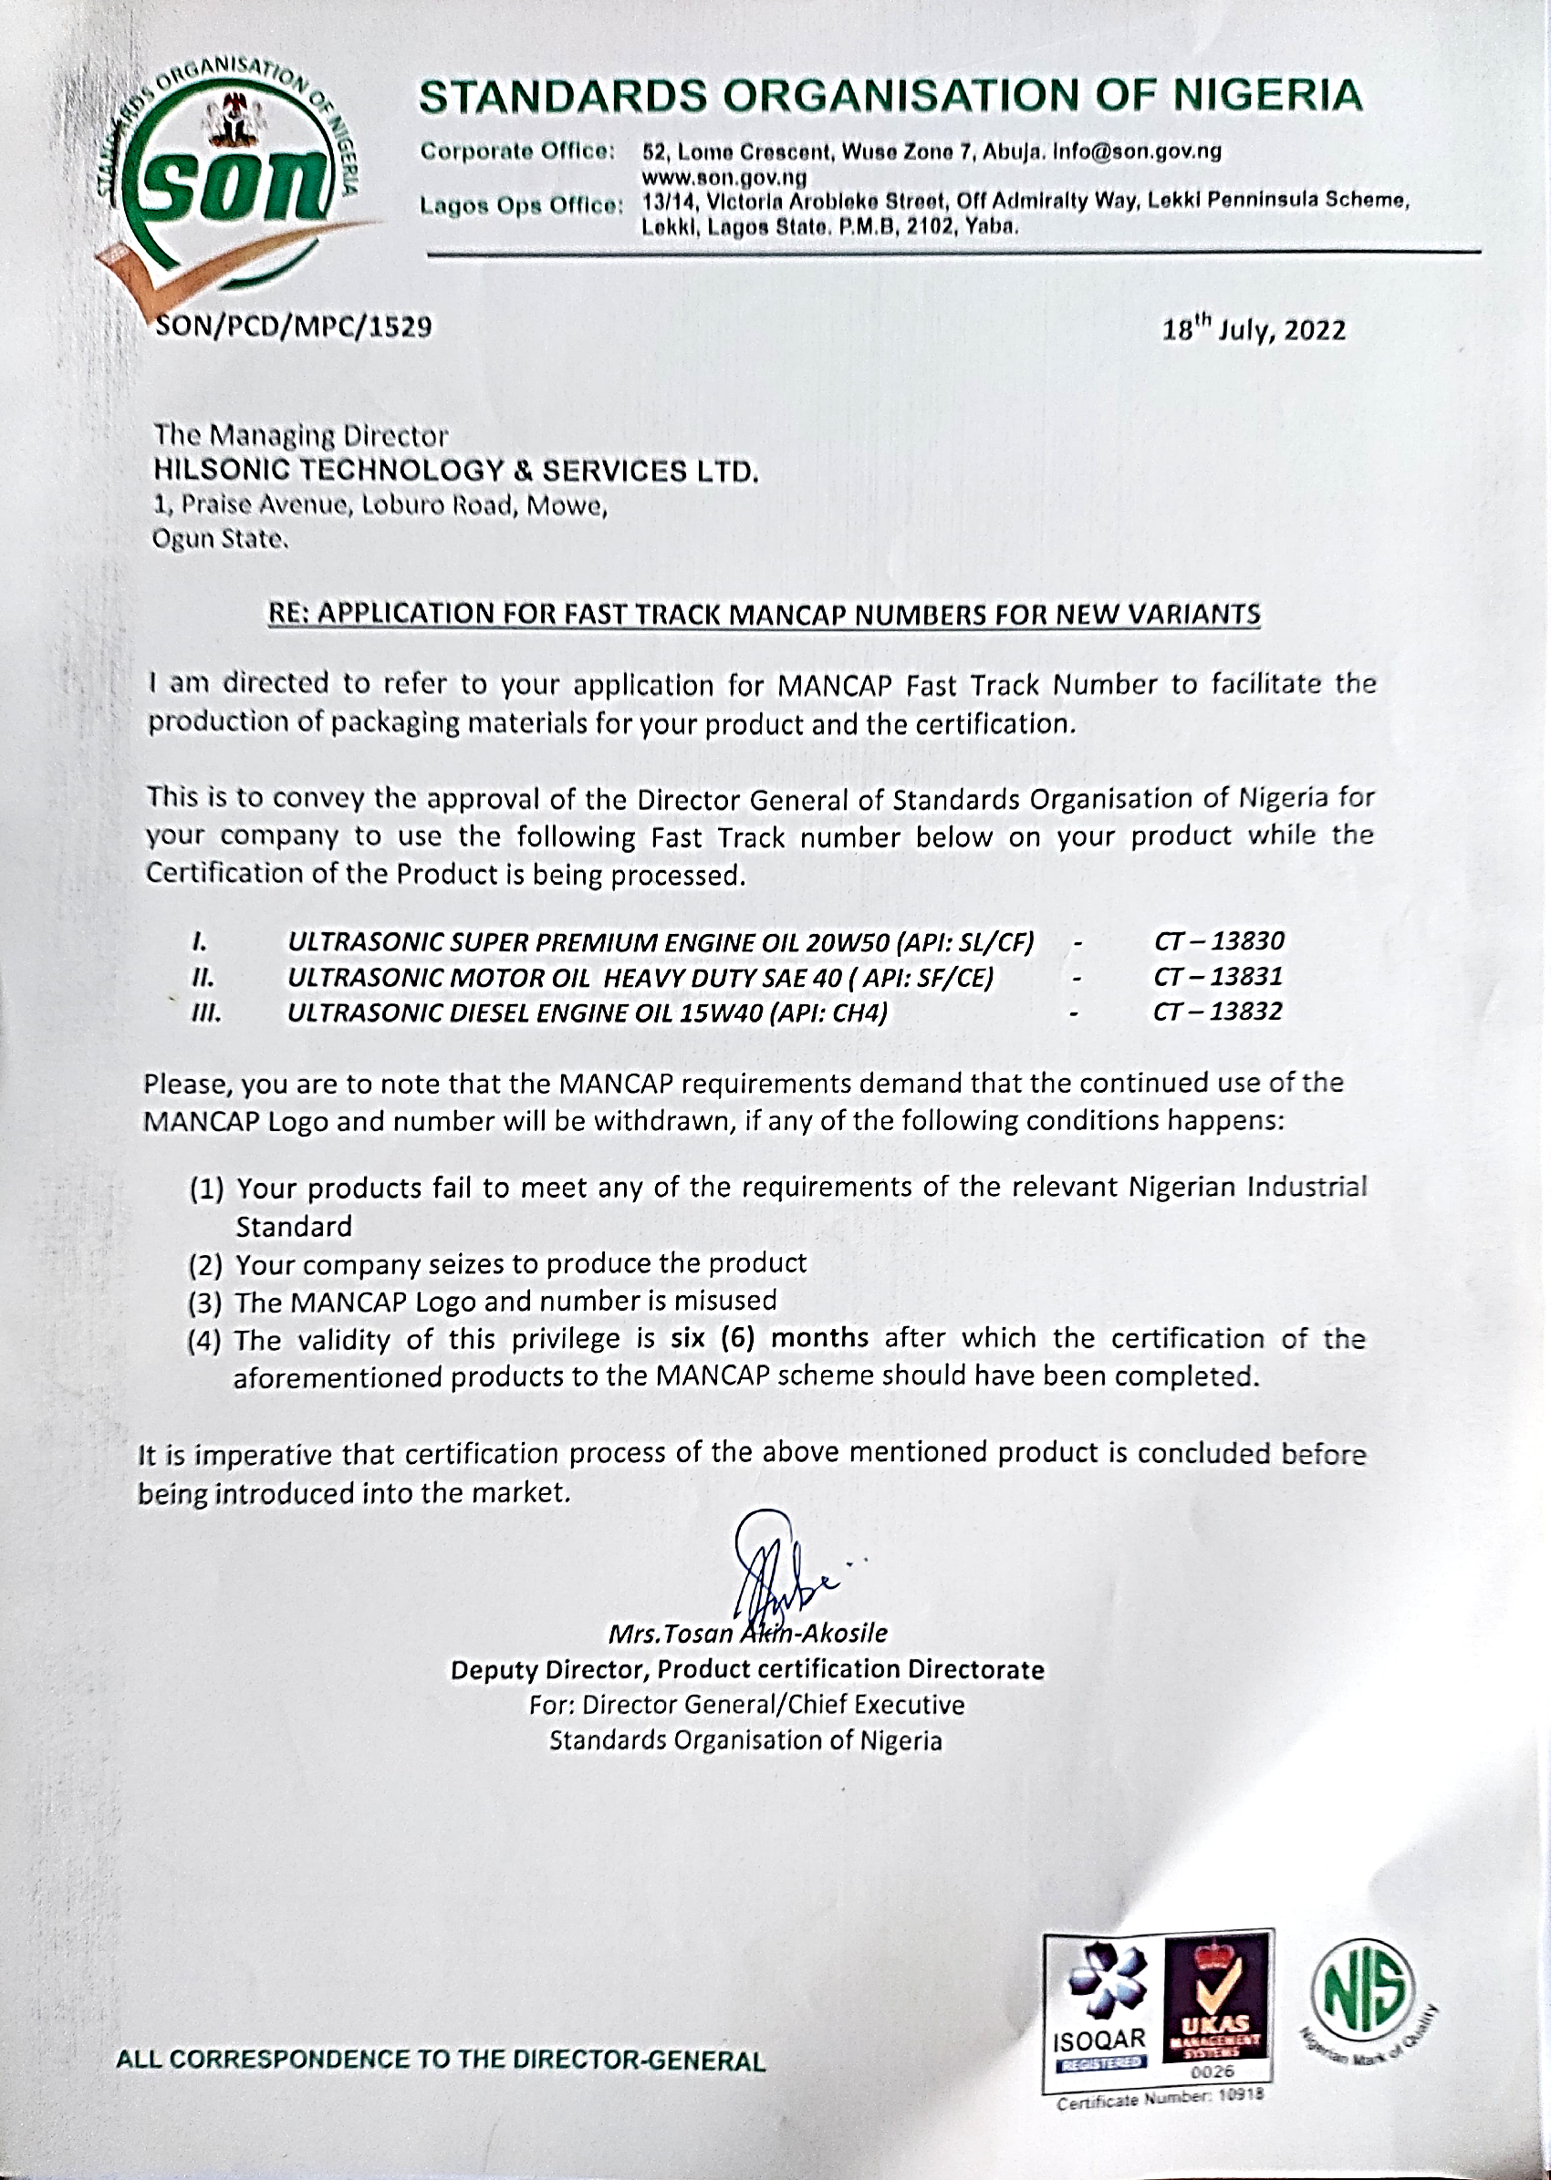
SON
Certification

Slide 15
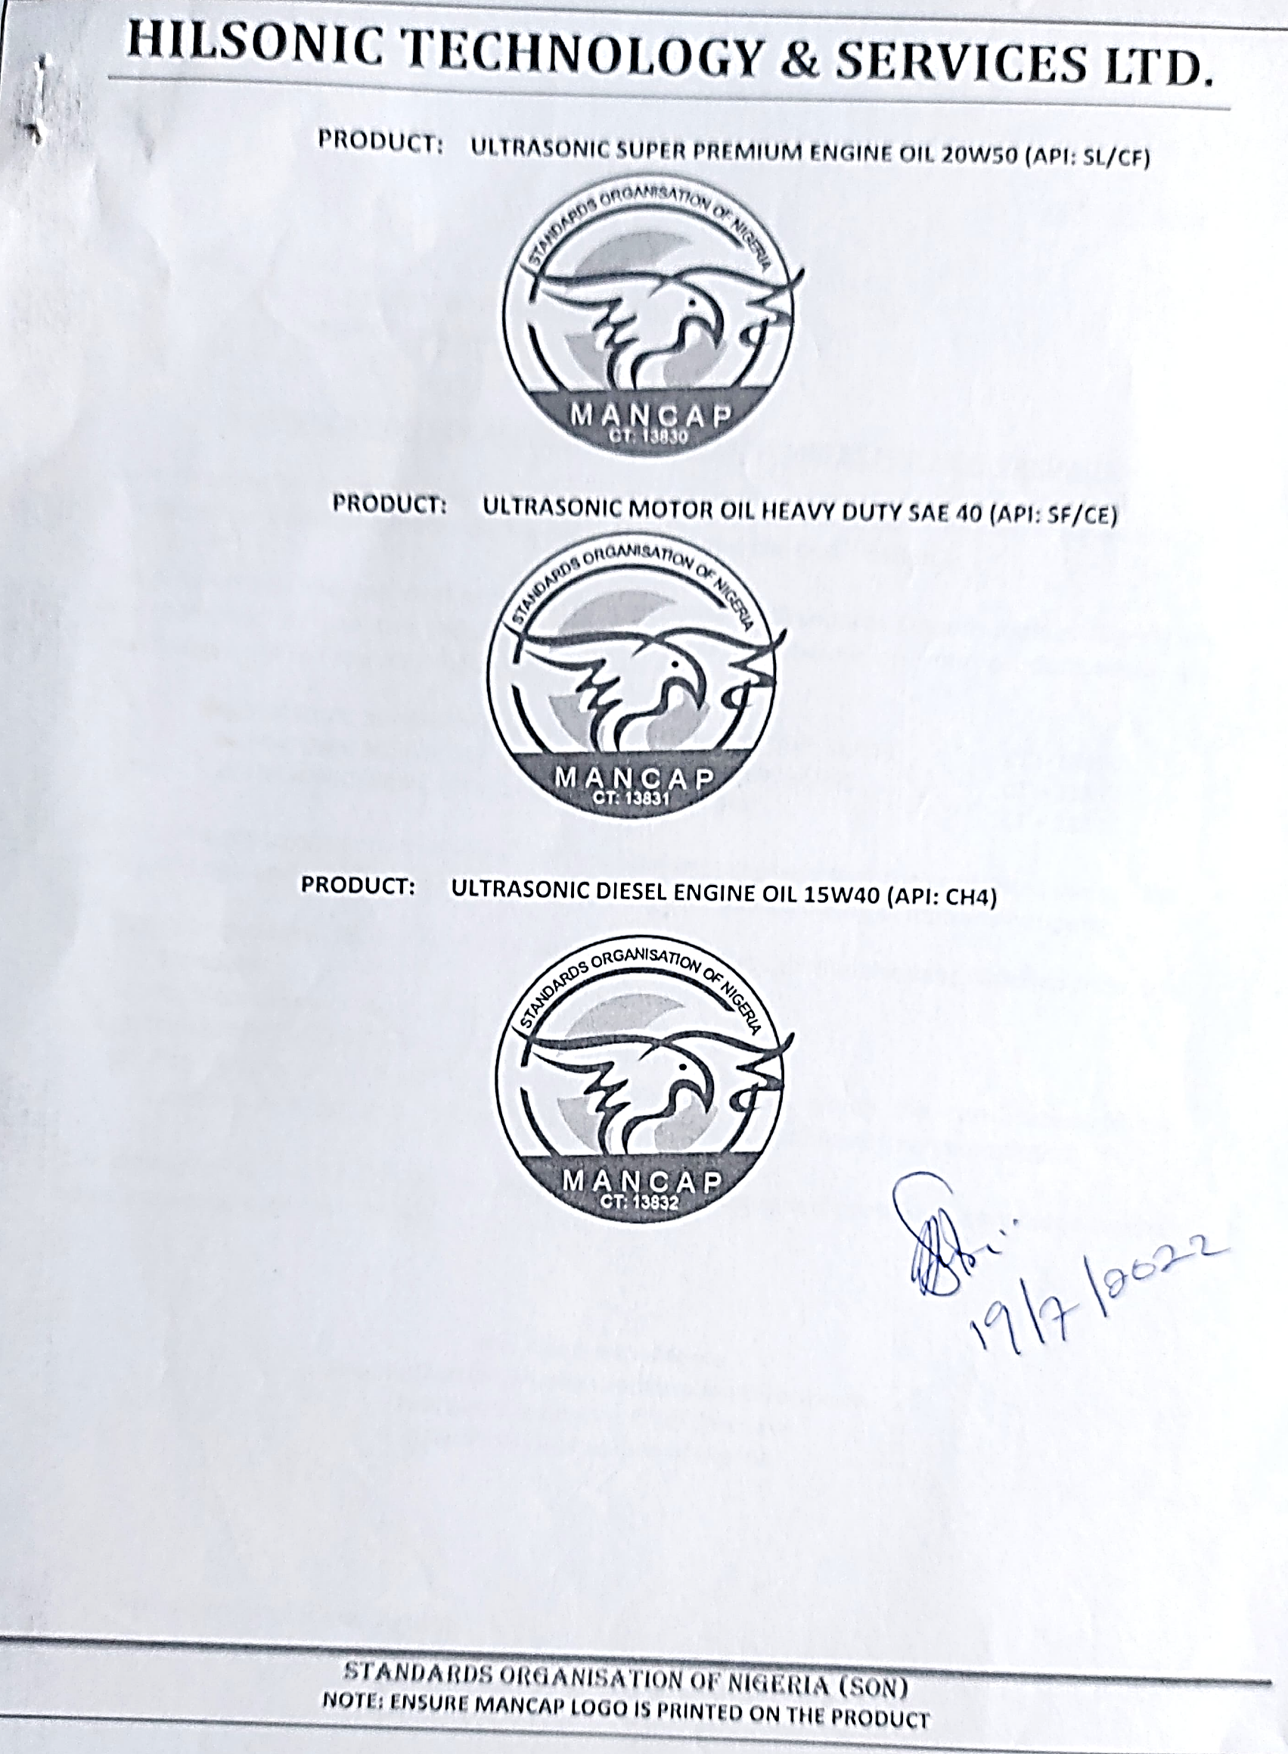
SON
Certification

Slide 16




ww
Contact
CONTACTS
Ify Caza.
Managing Director T: 08067732018
:: :ifycaza@hilsonictec.com
CONTACTS
Engr. Babatope. Technical Manager
T: 08105531901
CONTACTS
Chidi Ugochukwu. Floor Manager
T: 08034786910
CONTACTS
Hezekiah Omerebere. Admin. Manager
T: 08162867917
: :tony@hilsonictec.com
: :chidi@hilsonictec.com
:omerebere@hilsonictec.com
Plot 1, Praise Avenue, Loburo, Mowe Ogun State
www.hilsonictec.com

Slide 17
Hilsonic is the leading British manufacturer of ultrasonic
processing equipment. We supply a broad range of industry with standard and bespoke processors for the commercial market.
With over 35 years experience we pride ourselves on being the
experts in ultrasonic technology.
Our equipment is specifically designed and built for superior
performance, long life and continuous service with applications in marine, lubrication, paint and many other sectors in the UK and throughout the world.
In addition to manufacturing primary ultrasonic processing
equipment we oversee its installation and operations.
Many of our clients are reaping the benefits of our technology built
on the principals of sonochemistry, using as little as 3kw per unit and drastically reducing the mean carbon footprint to a minimum.
Hilsonic Process Equipment is designed and manufactured at
our base in the Wirral, UK. Our unique trandsducer and generator design is built to withstand the harshest environments while remaining simple for the end user to operate and service. Together with our proven ability to design and build completely in-house to suit any application has earned Hilsonic Process the reputation as...

